Slide 1
Logic Synthesis toolbox

Slide 2
Table of Contents
Boolean algebra and Truth table (Kitty) --1h
BDD (CUDD) --0.5h
SAT Solver (Z3) --0.5h
Logic network (Mockturtle)
AIG and others Gate-Inverter-Graph data structure --1h
Graph-related algorithms, e.g. cut_view, topo_view, … --1h
Standard cell Mapper --1h
Logic decomposition, restructure, and optimization --TBD

Slide 3
Lecutre-1 Truth Table

Slide 4
Truth table representation
Equivalent classes
P-equivalent class
NPN-equivalent class

Slide 5
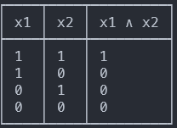
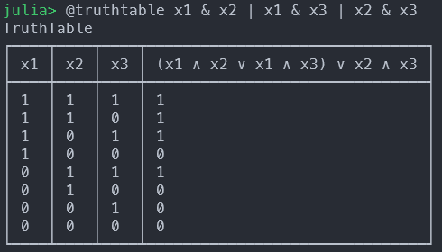
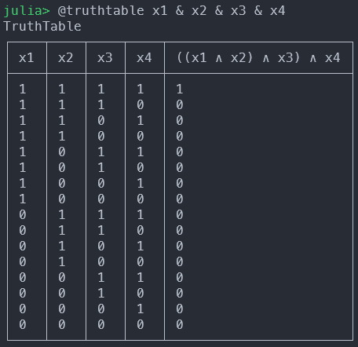
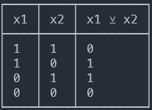
Truth table representation
AND2
MAJ3
AND4
XOR2

Slide 6
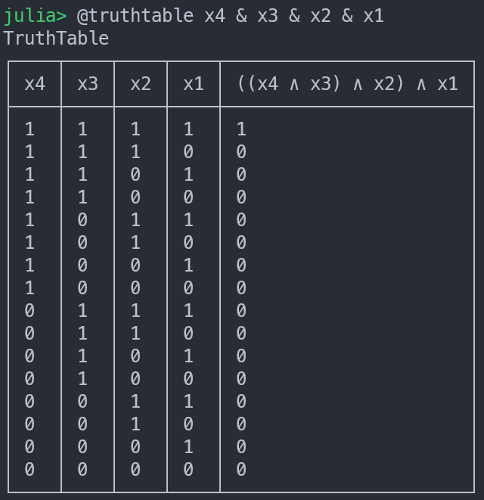

Truth table of input variables

Slide 7
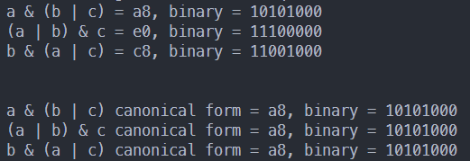
Equivalent classes

Slide 8
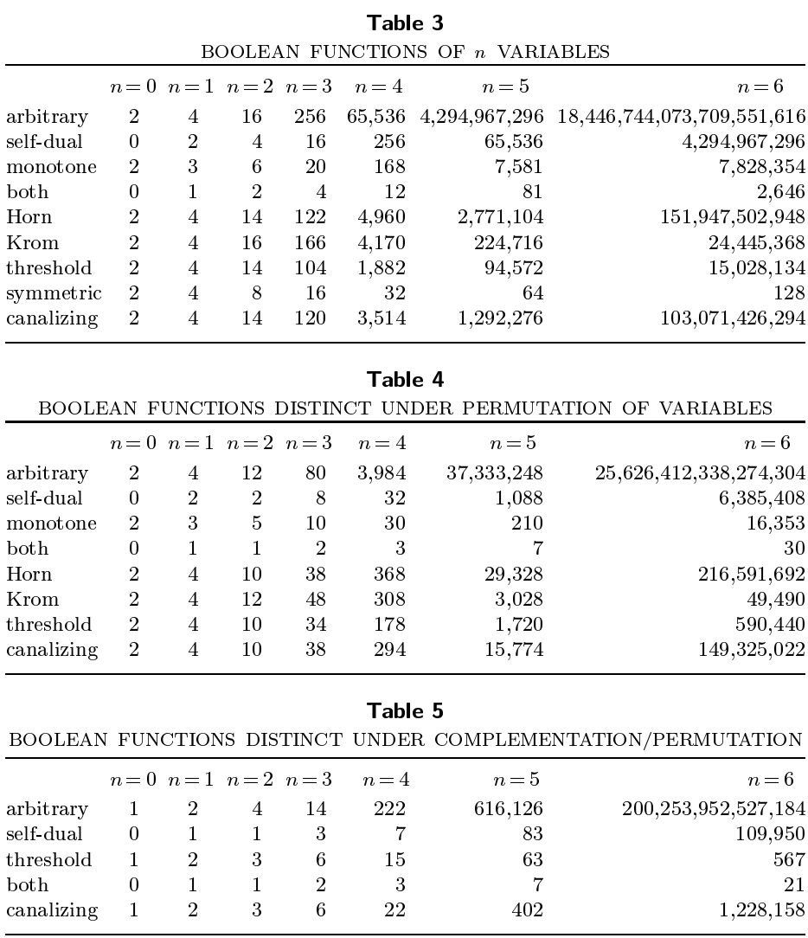
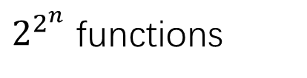
$2^{2^{n}}$ functions
P-equivalent functions
NPN-equivalent functions

Slide 9
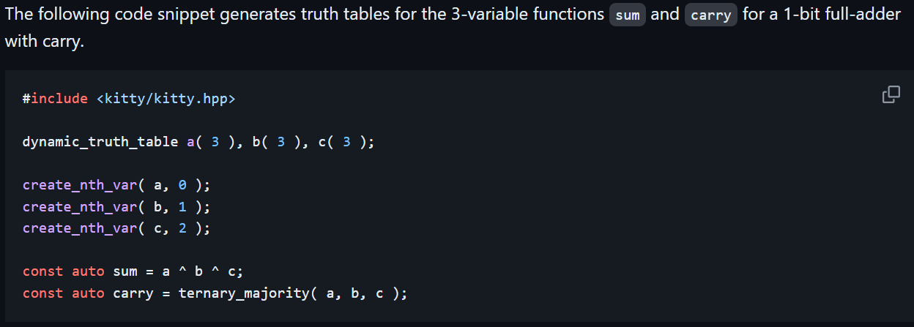
Kitty - a C++17 truth table library

Slide 10
Kitty library
Truth table data structure
Canonization algorithm
Output negation
Inputs permutation
Inputs negation

Slide 11
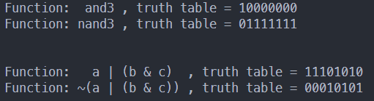
Output negation

Slide 12
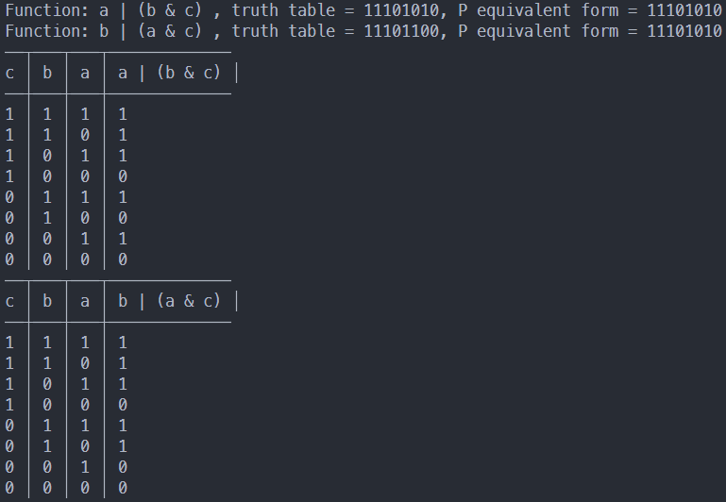
Inputs permutation

Slide 13
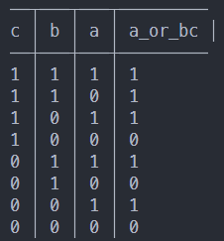
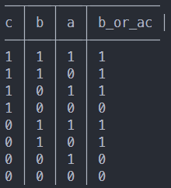
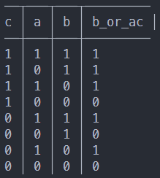
Swap to p-canonical form
11101100
11101010

Slide 14
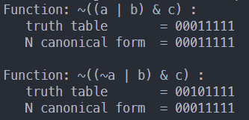
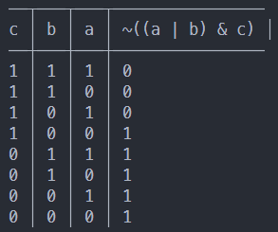
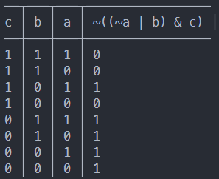
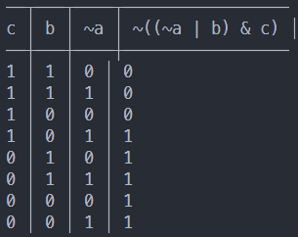
Inputs negation

Slide 15
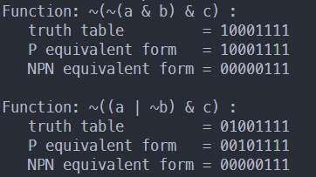
NPN

Slide 16
Reference
BDD:
Knuth TAOCP Vol. 4a
Kitty

